Slide 1
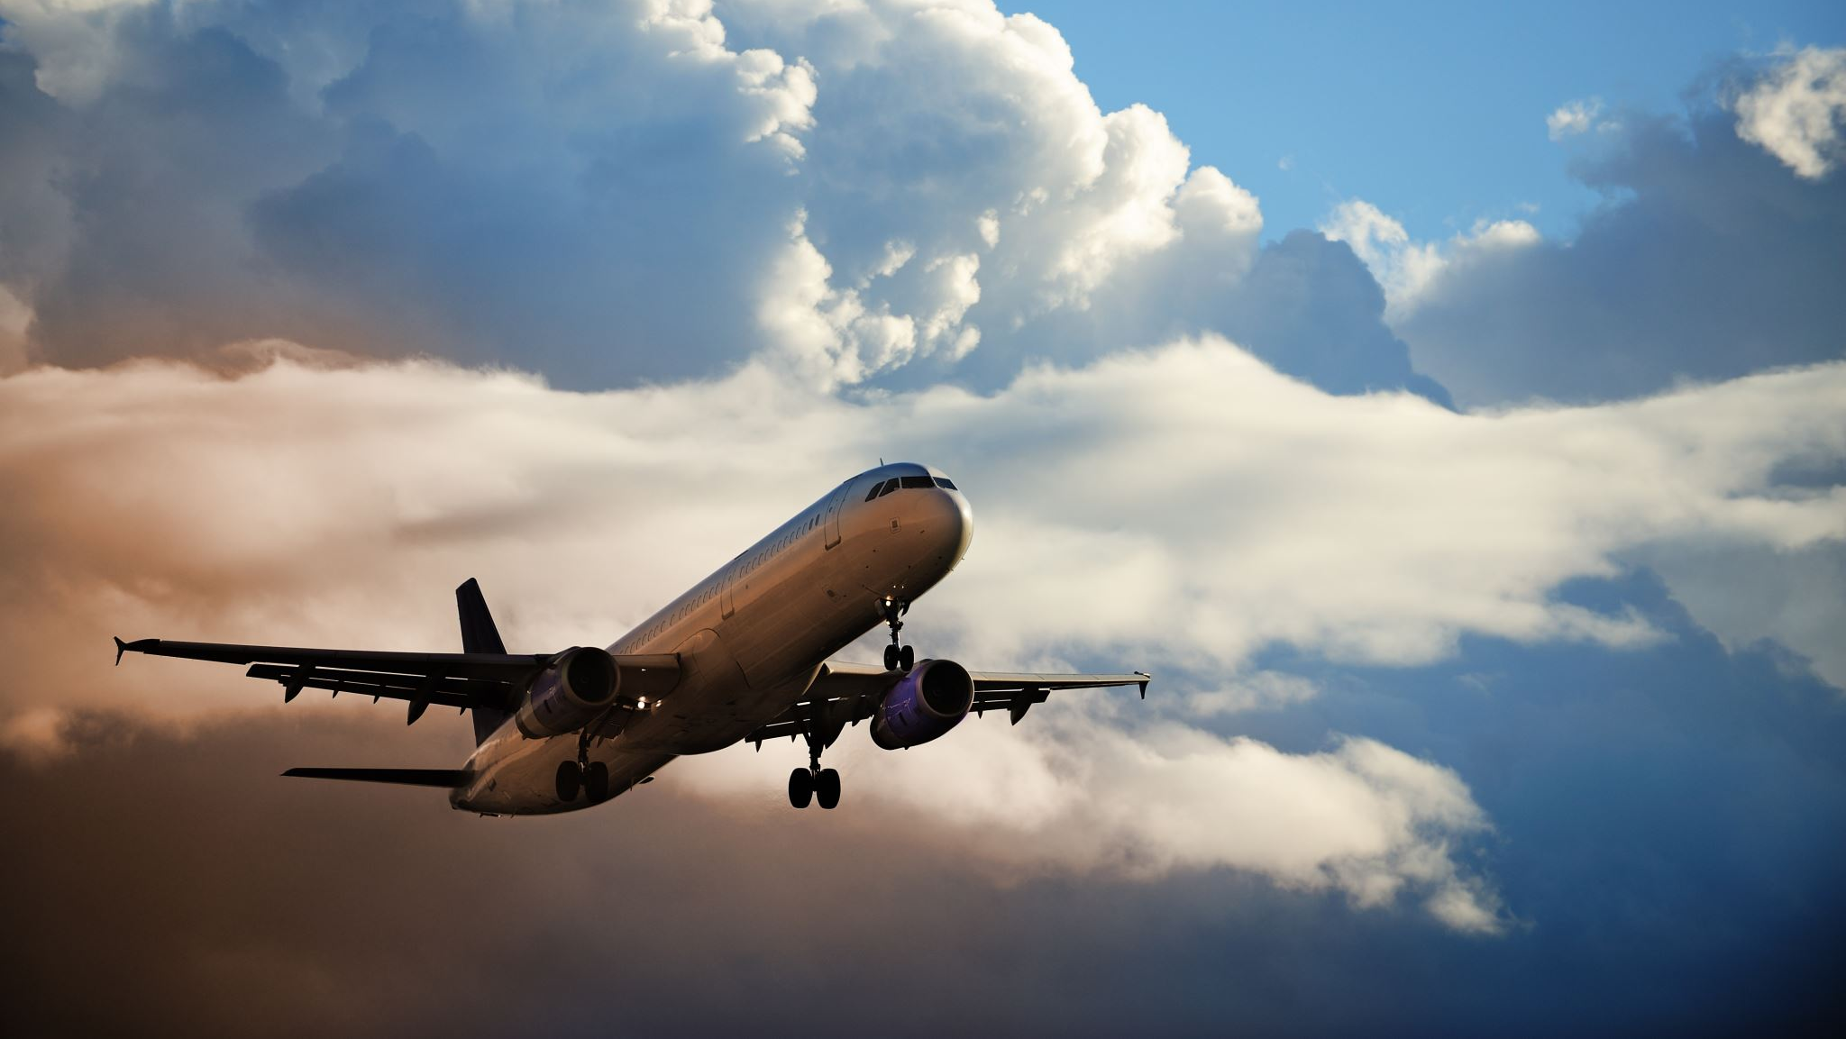
Predicting Flight Delays
By: Owen Brush, Brian Lu, Amir Shakouri

Slide 2


LHL AIRLINES | LHL AIRLINES
Where your concern of flight delays is our concern
Where your concern of flight delays is our concern
Federal Aviation Administration (2016-2019)*
Delays cost passengers ~15.65 Billion a year
Accurately predicting delays help minimize costs and optimize fuel consumption
How do we predict arrival delay?
PASSENGERS
Planning to:
Arrive on time for flights
Following through on premade plans
Make it to destination in timely manner
AIRLINES
Help predict flight arrival at gates
Save on crew, fuel and maintenance expenses
Brand integrity
Passengers ticket insurance
*Source https://www.faa.gov/data_research/aviation_data_statistics/media/cost_delay_estimates.pdf
Notes:
Passengers want to know flight delays if they are planning to

Slide 3
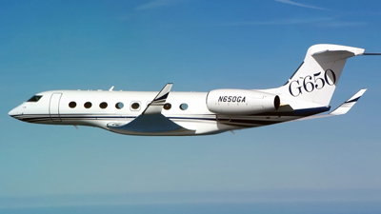
Feature Selection: 10 -> ~40
Flight ID
Tail Number
Origin
Destination
Arrival time
Departure time
Weather (Destination and Origin)
Distance
CRS Flight Time
Day of the Week
Historical average delays for the entire dataset
(2018-2019 Data)
The sine and cosine of arrival time and departure time.
From an online dataset*
Dependent on flight given
*Source: https://www.kaggle.com/sobhanmoosavi/us-weather-events

Slide 4

Passenger / Airline
Where does Machine learning come into play?
Flight details
Machine Learning
Classifier
< 15 mins
> 15 mins
Machine Learning Regression
On Time / Early
Late / Delayed
How Long?
Not Long
Too Long
Announcement + apology to customers
In case of emergency
…

Slide 5
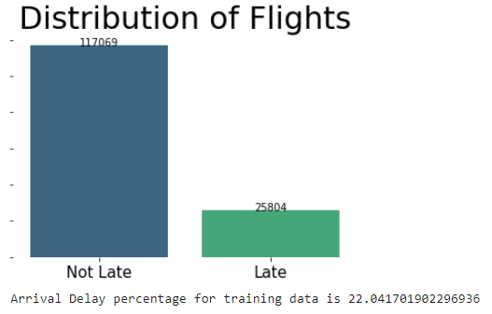
Binary Classification Late arrival | On time?
Random Forest Classifier
Tried Multiple!
Evaluation Metric:
Recall: 0.67..
Precision: 0.30..
Accuracy: 0.67..
F1 Score: 0.42…
Picked a model with higher Recall.
Rather have more on time flights labeled as Late.

Slide 6
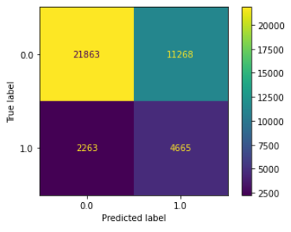
Binary Classification Late arrival | On time?
Confusion Matrix for Random Forest Classifier
Random Forest Classifier
Tried Multiple!
Evaluation Metric:
Recall: 0.67..
Precision: 0.30..
Accuracy: 0.67..
F1 Score: 0.42…
Picked a model with higher Recall.
Rather have more on time flights labeled as Late.
True On time
False Late
False On time
True On time

Slide 7
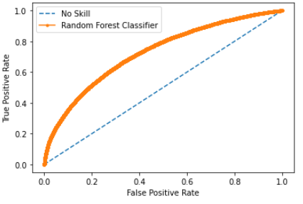
Binary Classification Late arrival | On time?
ROC Curve: Random Forest Classifier
No skill AUC = 0.500
Model is unable to distinguish between classes
Random Forest Classifier AUC = 0.727
73% chance the model can distinguish between classes
Decent for predicting if a plane will be late or not.

Slide 8
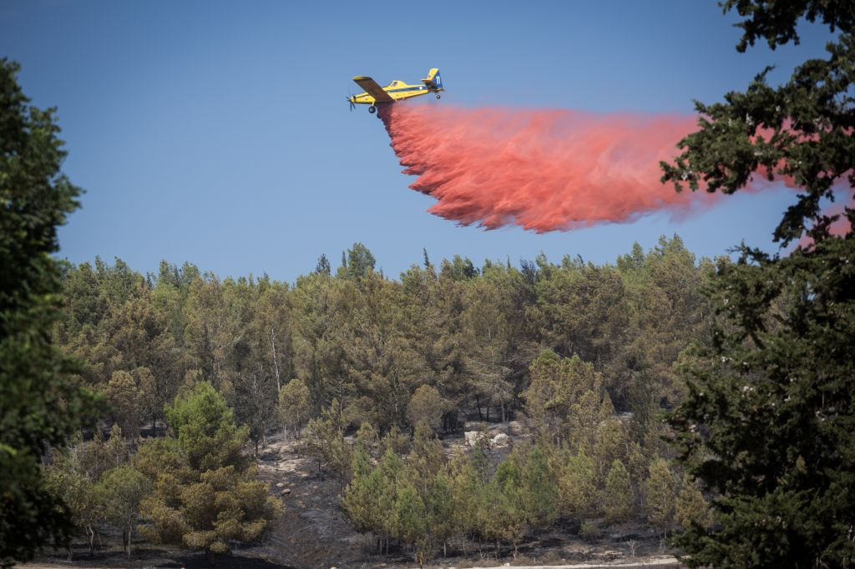
Regression Predicting arrival delay times
Random Forest Regressor
Over 150 tests ran
11 different models tested…
Evaluation Metric:
MSE: 634.5
MAE: 16.8
R² score: 0.18
Our model predicts on average, a plane will be 1 minute early!
Improves day to day operations!
But… can’t predict cascading delays

Slide 9
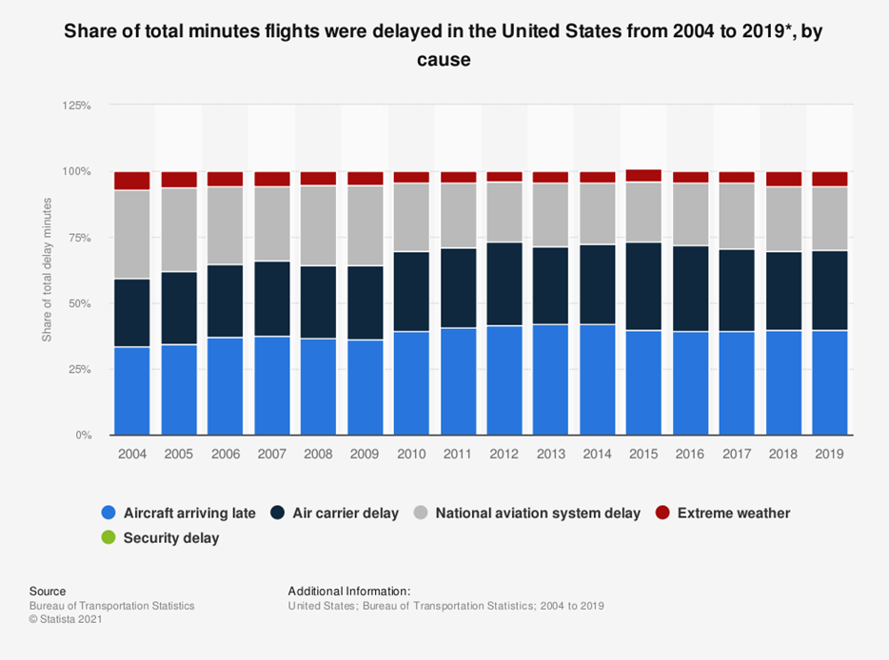
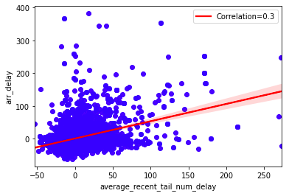

Model Improvement: Dynamic Averaging
The Problem: Self-dependency of arrival delay
Not: X * Delay
Delay = X(Delay) + Weather+ …
Share of total delay in minutes
The Solution:
Engineering dynamic averaging feature(s) that track most recent delays over time.
At any given point in time, this feature shows good correlation with the target
Source: https://www.bts.gov/topics/airlines-and-airports/understanding-reporting-causes-flight-delays-and-cancellations

Slide 10
Example Regression model: w/ new Feature
Features list + Average Recent Tail Number Delay
Grid Search w/ Random Forest Regression
Future development required:
Adding/improving new features
Increasing sampling efficiency
(to extract Average Recent TN Delay)
Updating the dynamic average for testing
GridSearchCV

